Slide 1
Graph Neural Networks and Transformers Workshop
ENCCS and RISE
Erik Ylipää and Leon Sütfeld

Slide 2
Workshop outline
Thursday October 21
Friday October 22
09:00 - 09:20 | Workshop intro
09:20 - 10:00 | Intro for session 1 notebooks: Graphs and what to do with them
10:00 - 12:00 | Work on notebooks
12:00 - 13:00 | Lunch break
13:00 - 13:30 | Intro for session 2 notebooks: From graphs to tensors
13:30 - 15:50 | Work on notebooks
15:50 - 16:00 | Recap of the day
09:00 - 09:30 | Intro to session 3, Inner workings of Graph Neural Networks
09:30 - 12:00 | Work on notebooks
12:00 - 13:00 | Lunch break
13:00 - 13:30 | Intro for session 4 notebooks: From GNNs to Transformers
13:30 - 15:40 | Work on notebooks
15:40 - 16:00 | Recap of the workshop

Slide 3
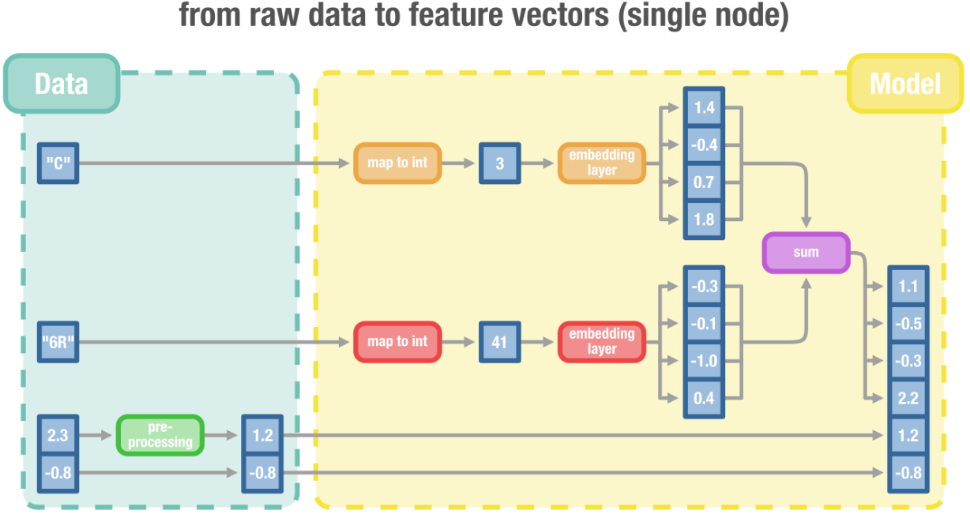
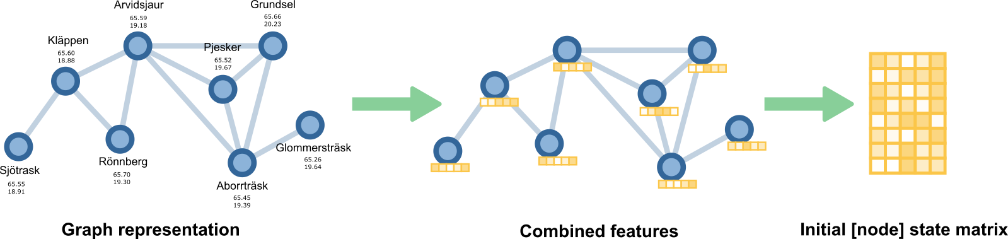
From graphs to tensors
SESSION 1

Slide 4
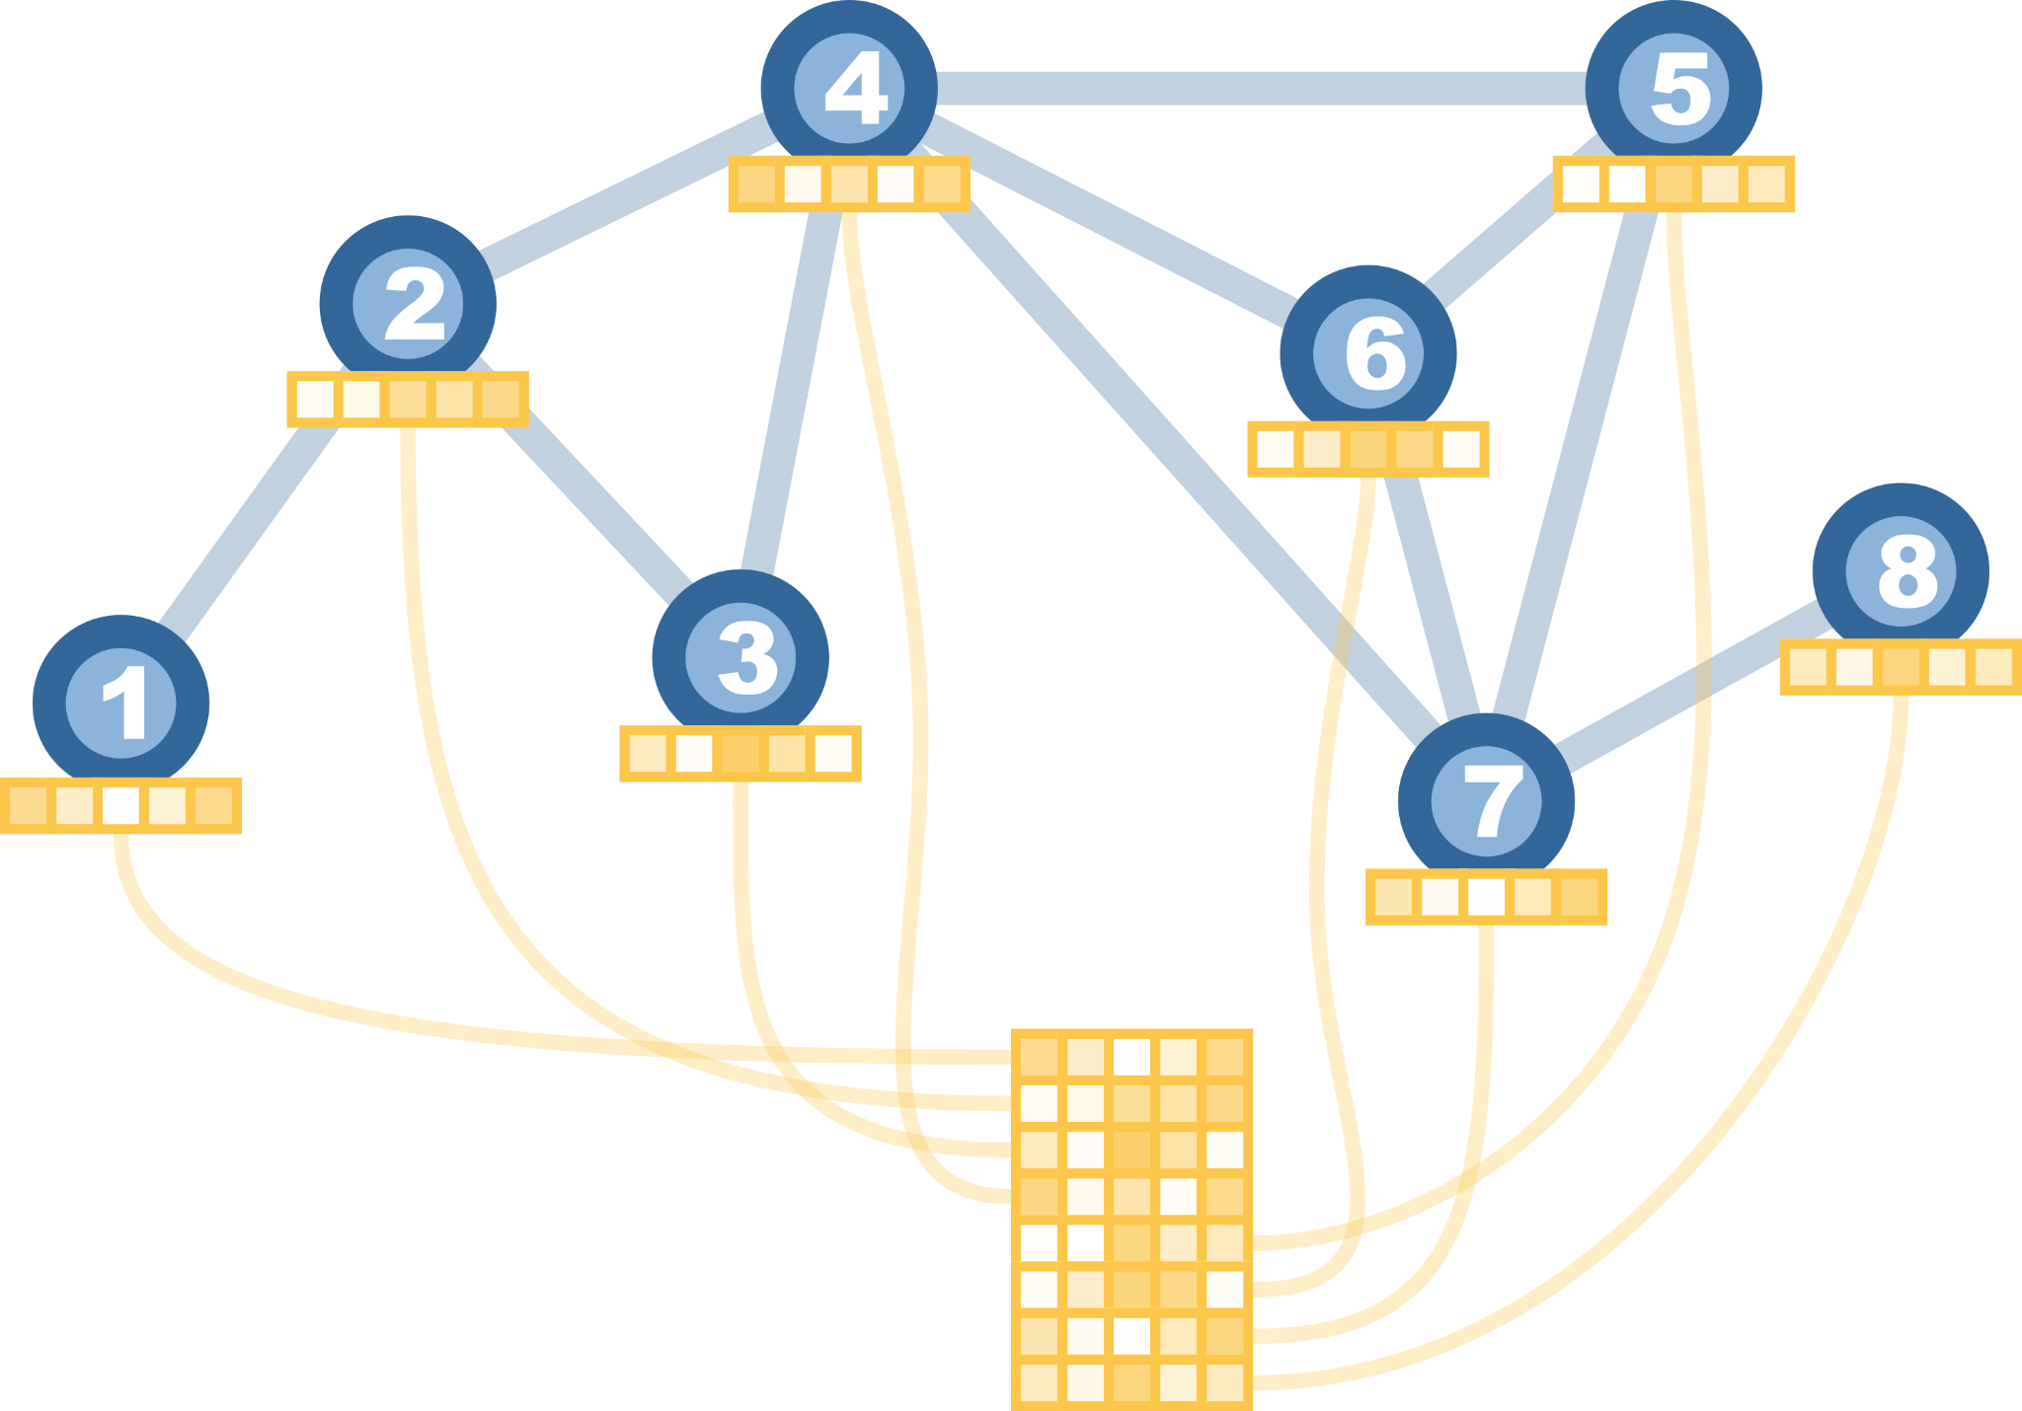
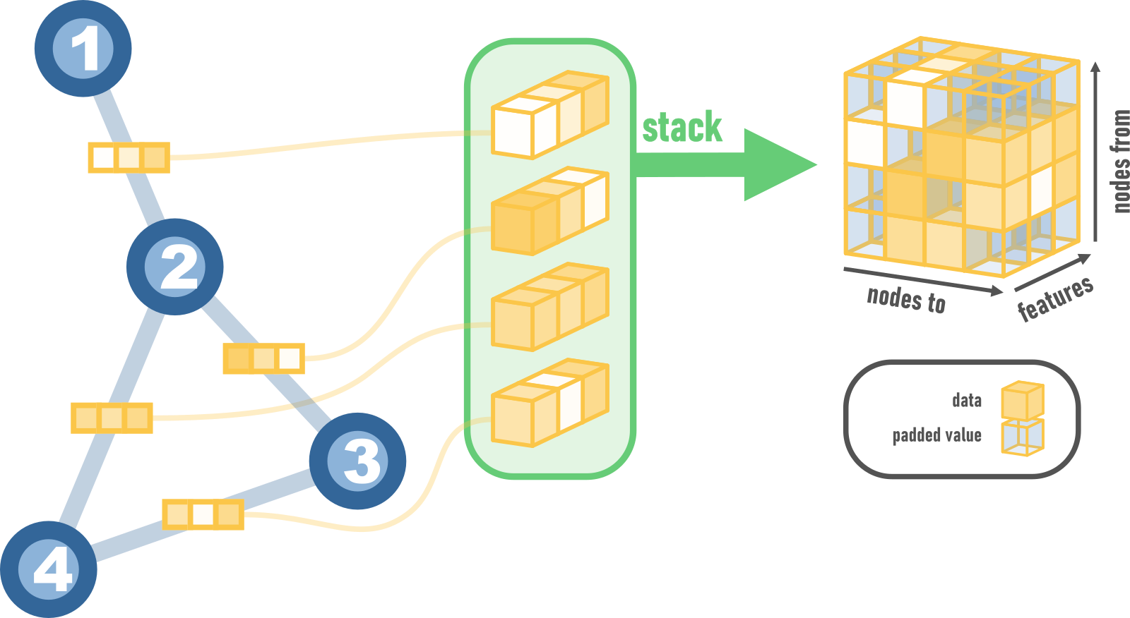
From graphs to arrays
SESSION 2
Node features
Edge features

Slide 5
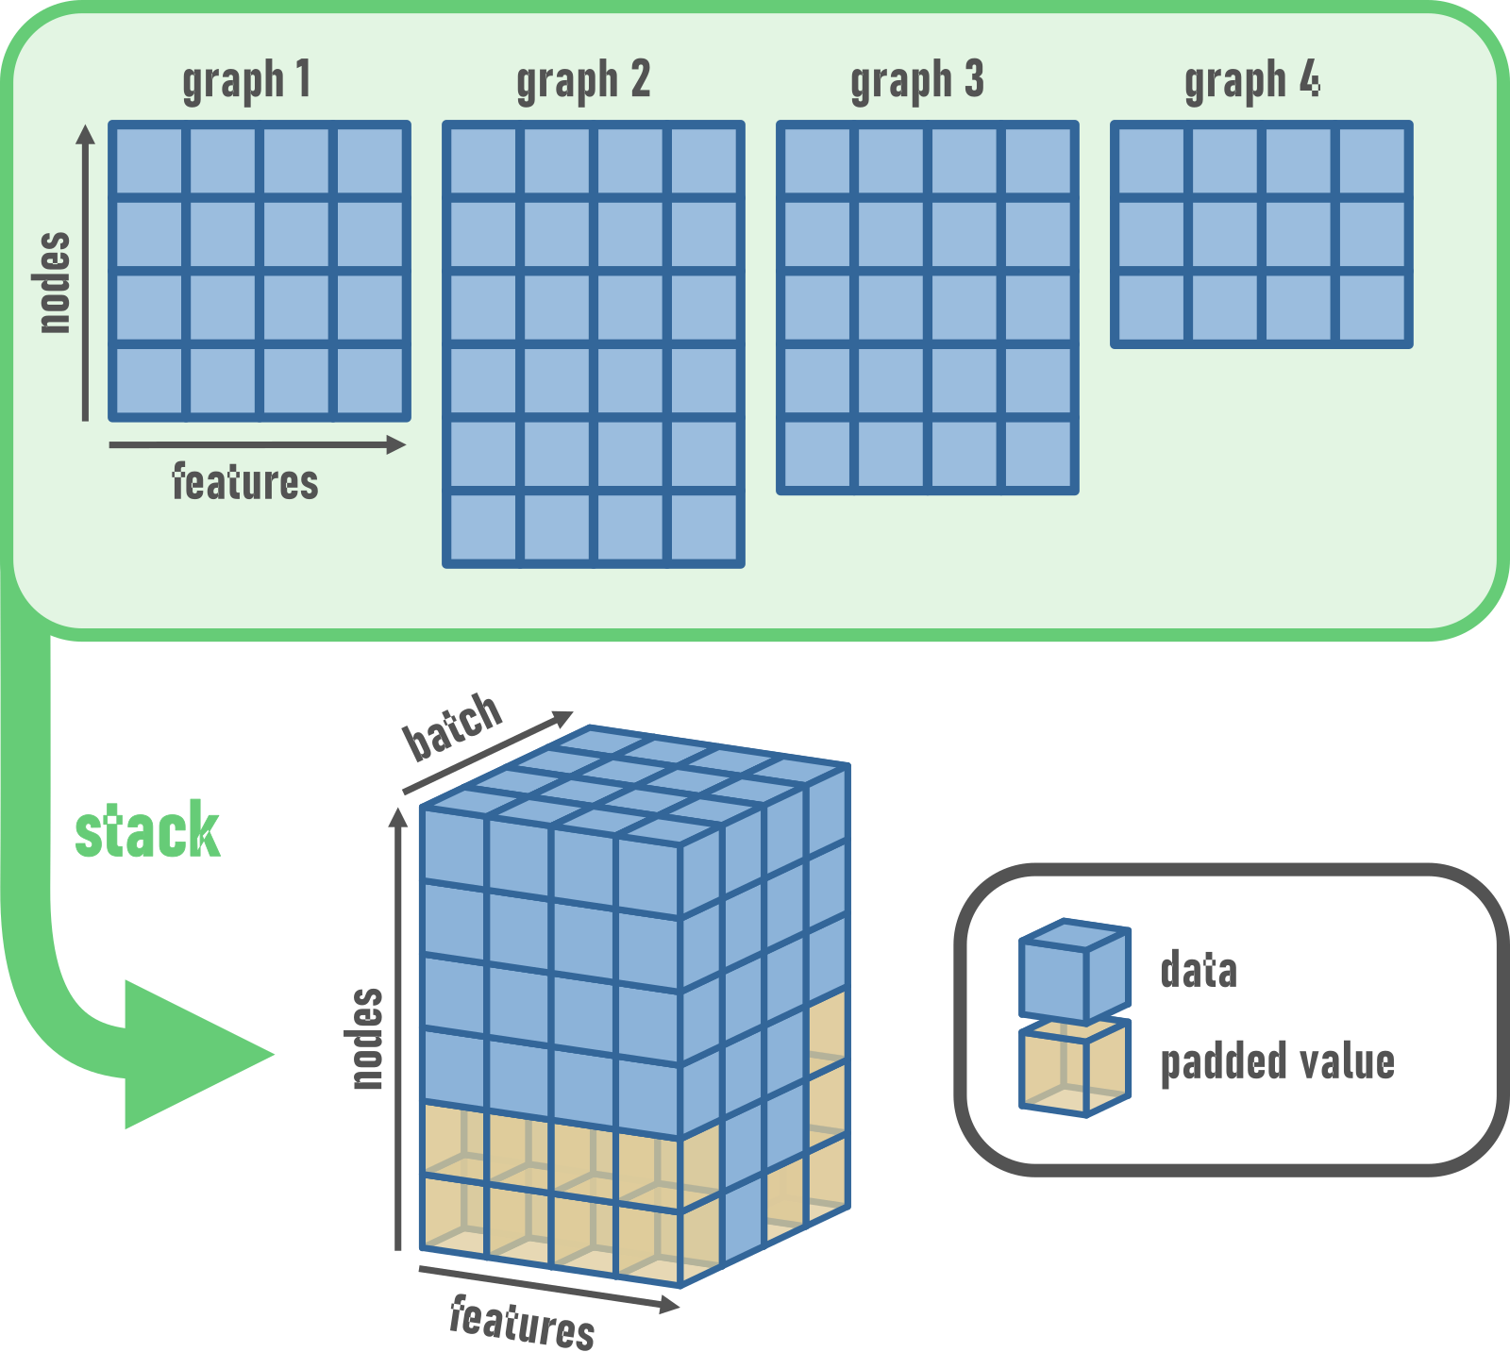
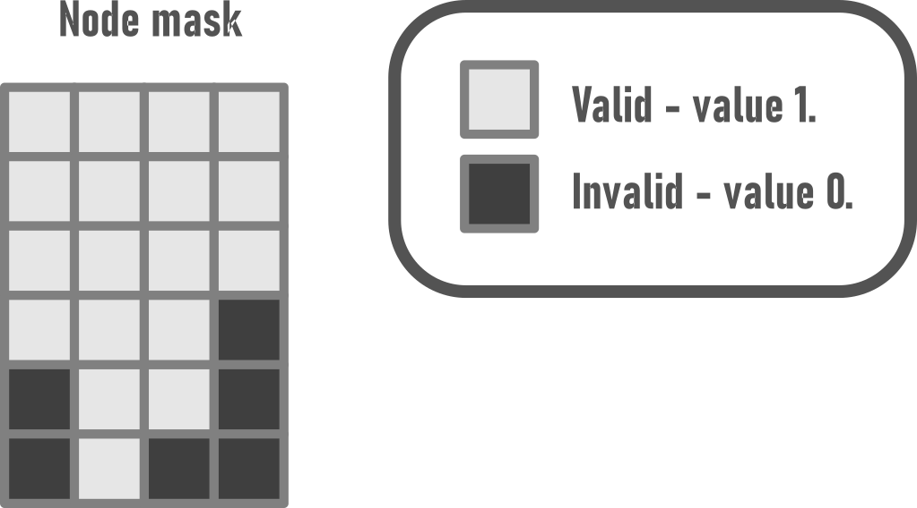
Batches and masks
SESSION 2

Slide 6
GNNs from the ground up

Slide 7
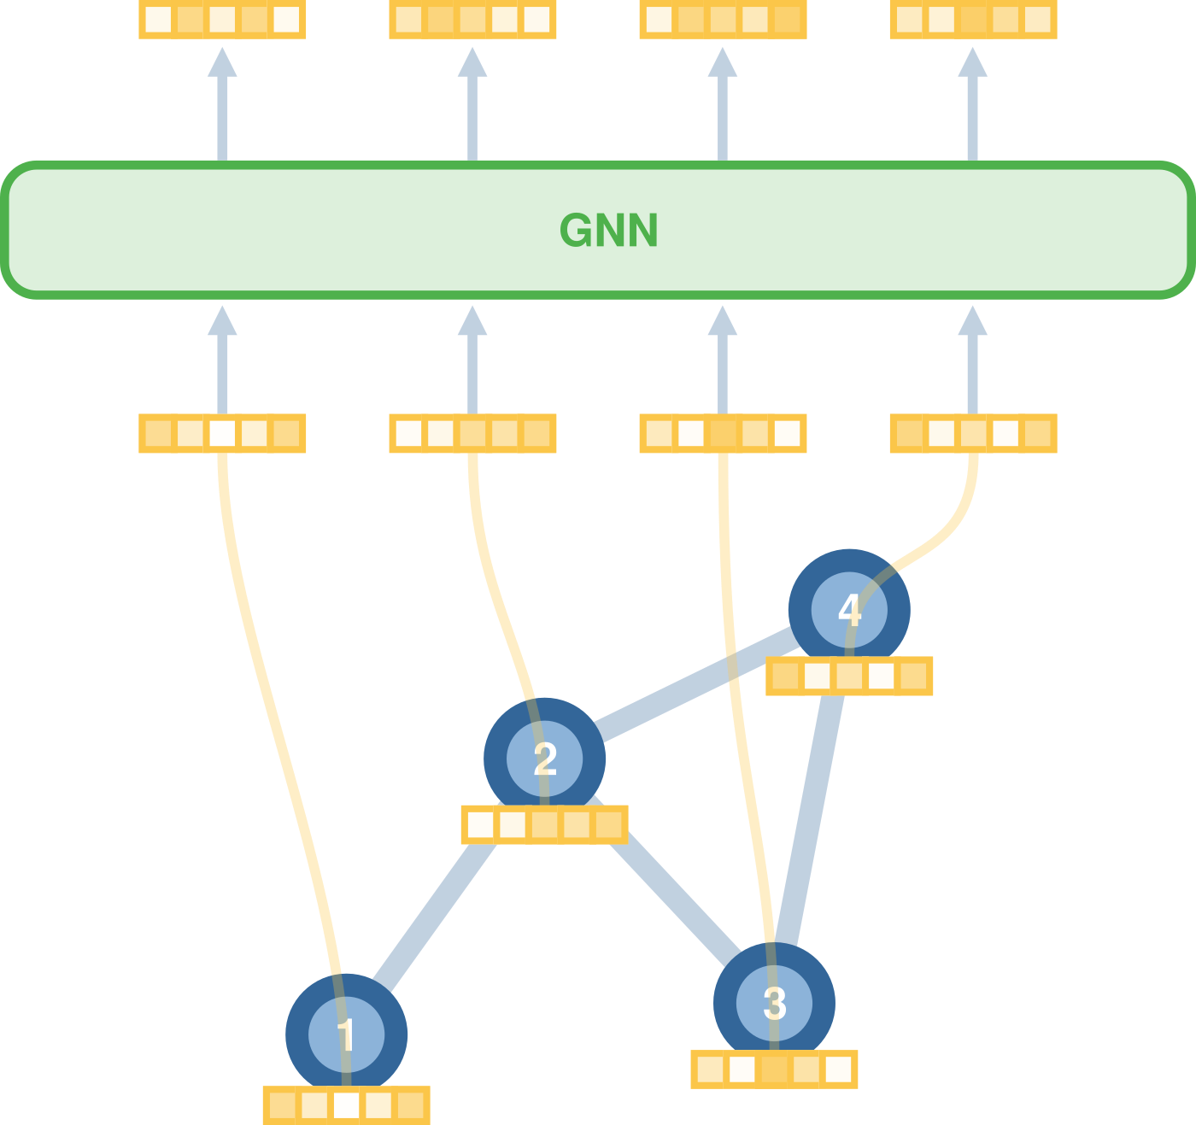
Back to GNNs
Notes:
It is not limited to input sizes. 10 nodes expecting it to generalize for 100 nodes can be a bit of a stretch. This is a common feature with RNN.

Slide 8
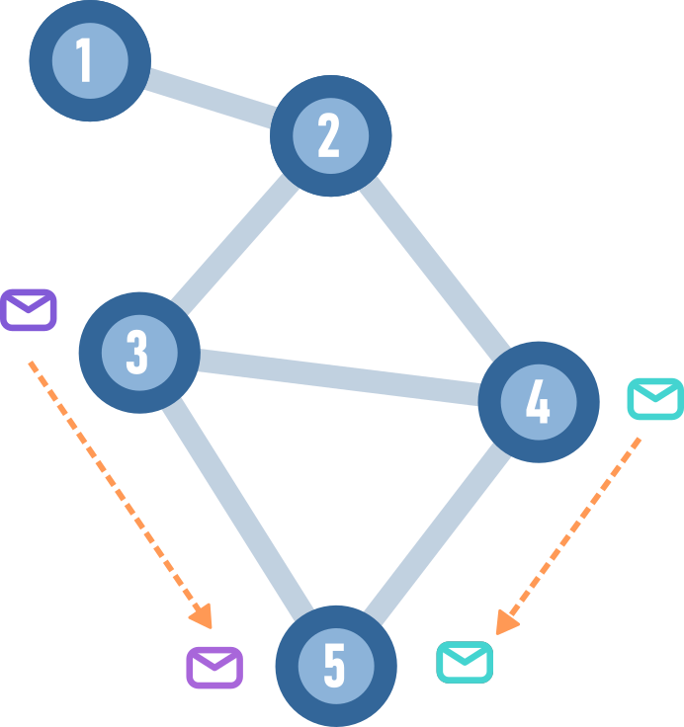
Message Passing view of GNNs
By repeating a simple local rule we can get information about large scale structure
Rule: my neighbours tells me what they think I should know
Notes:
They are known as gossip networks.

Slide 9
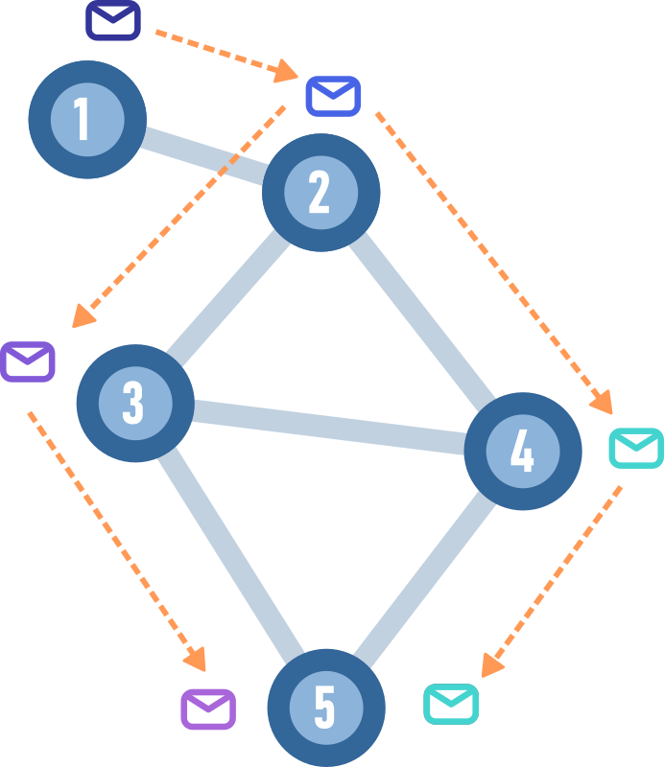
Message Passing view of GNNs
By repeating a simple local rule we can get information about large scale structure
Rule: my neighbours tells me what they think I should know
This is done for all neighbourhoods
After three iterations, I know what my 3 hop neighbours think we all should know

Slide 10
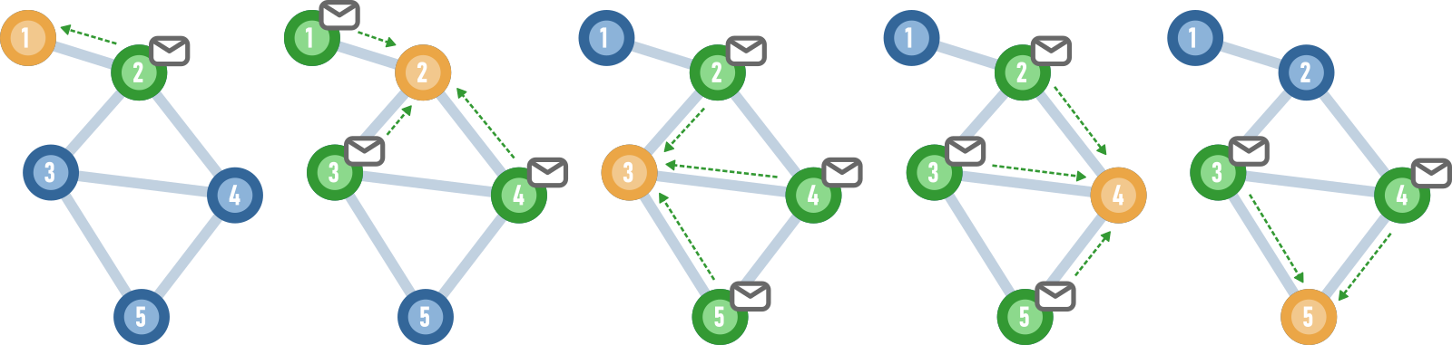
Message passing “centered” on a node
At each iteration, all nodes receive messages from their neighbours
We can think of all nodes actings as “centers” of a neighbourhood

Slide 11
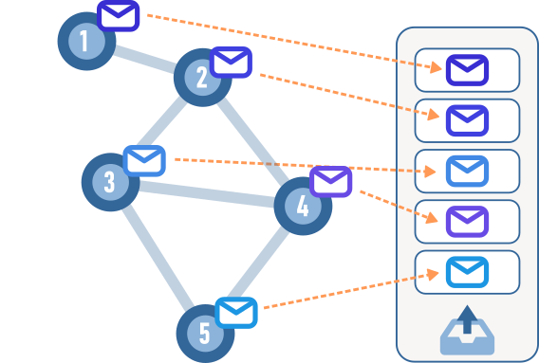
Message passing in practice
Place outgoing messages in an “outbox”

Slide 12
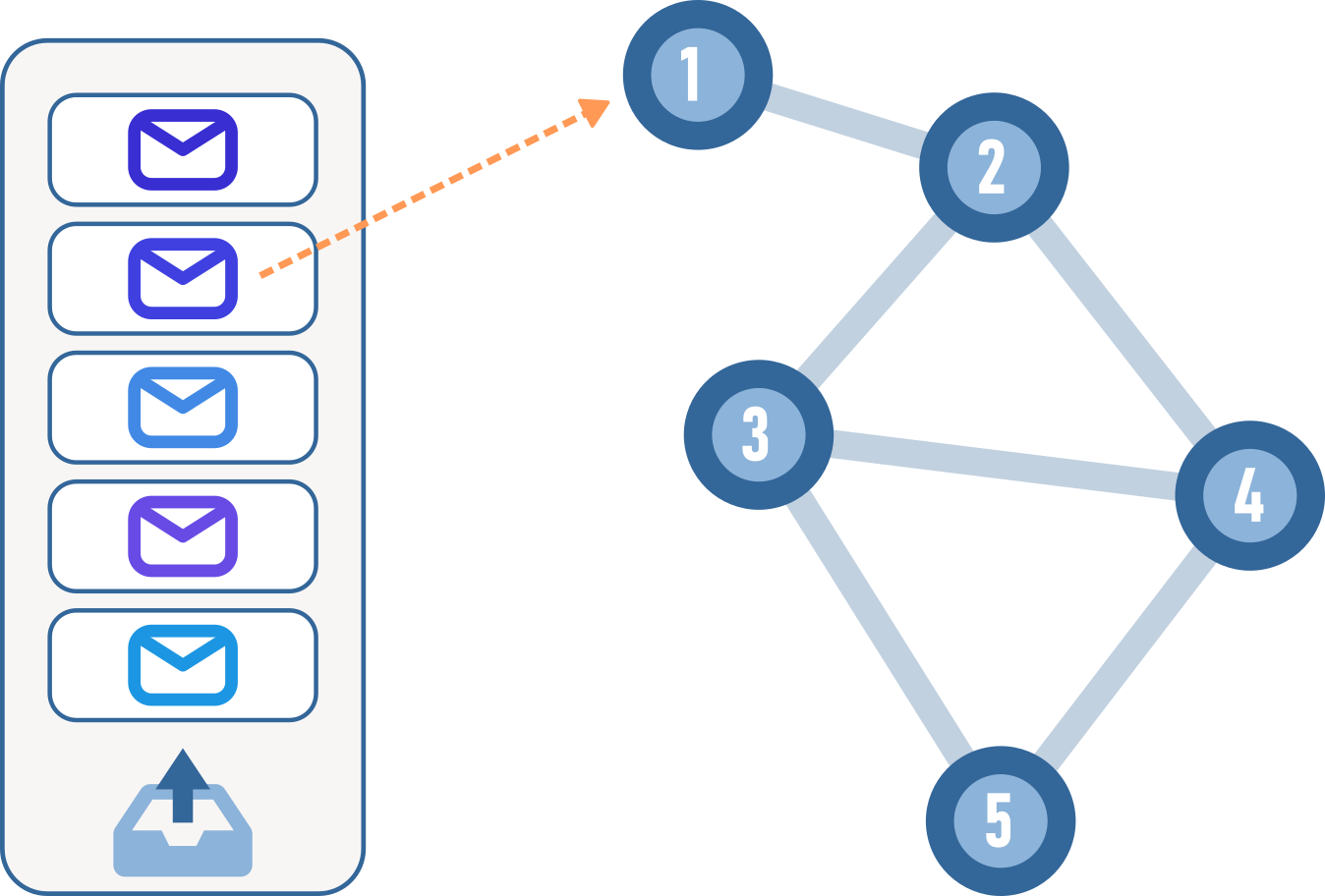
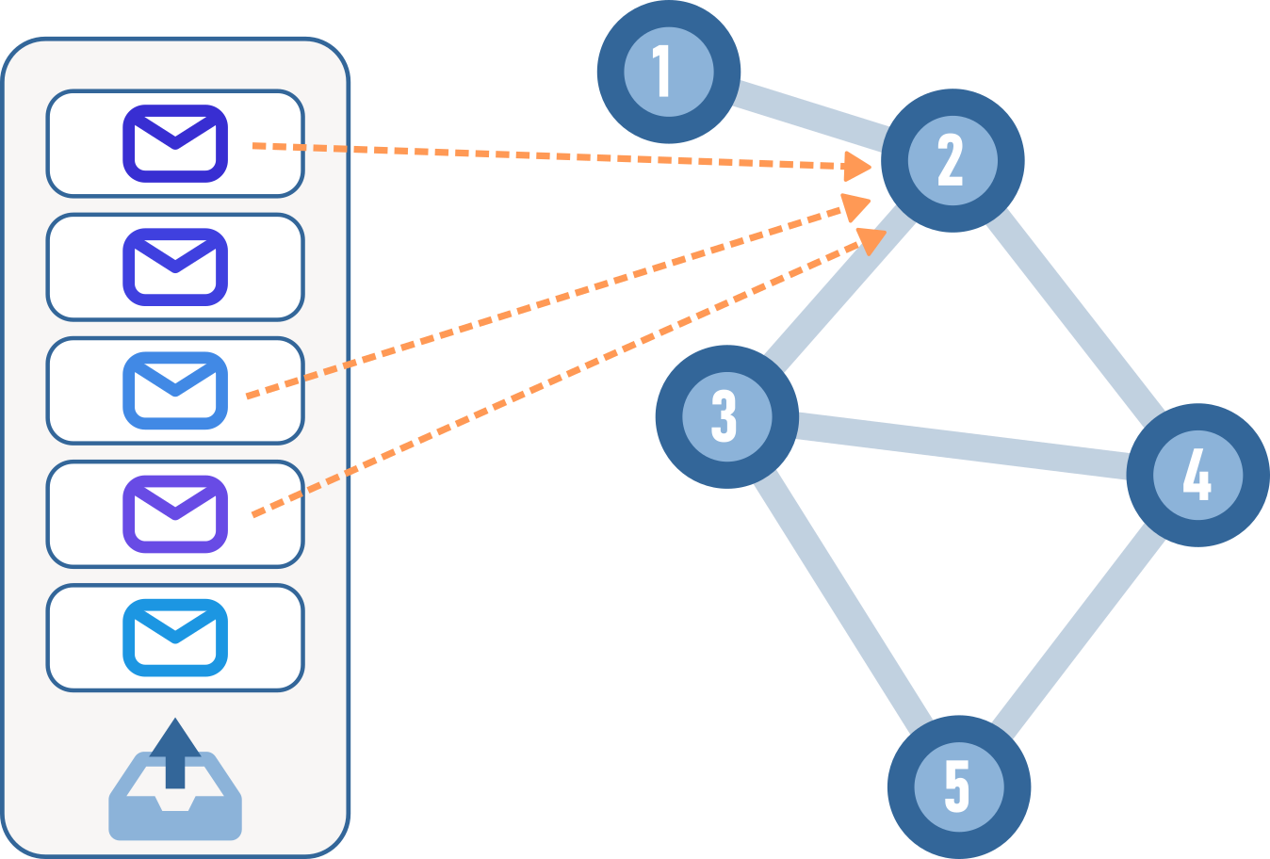
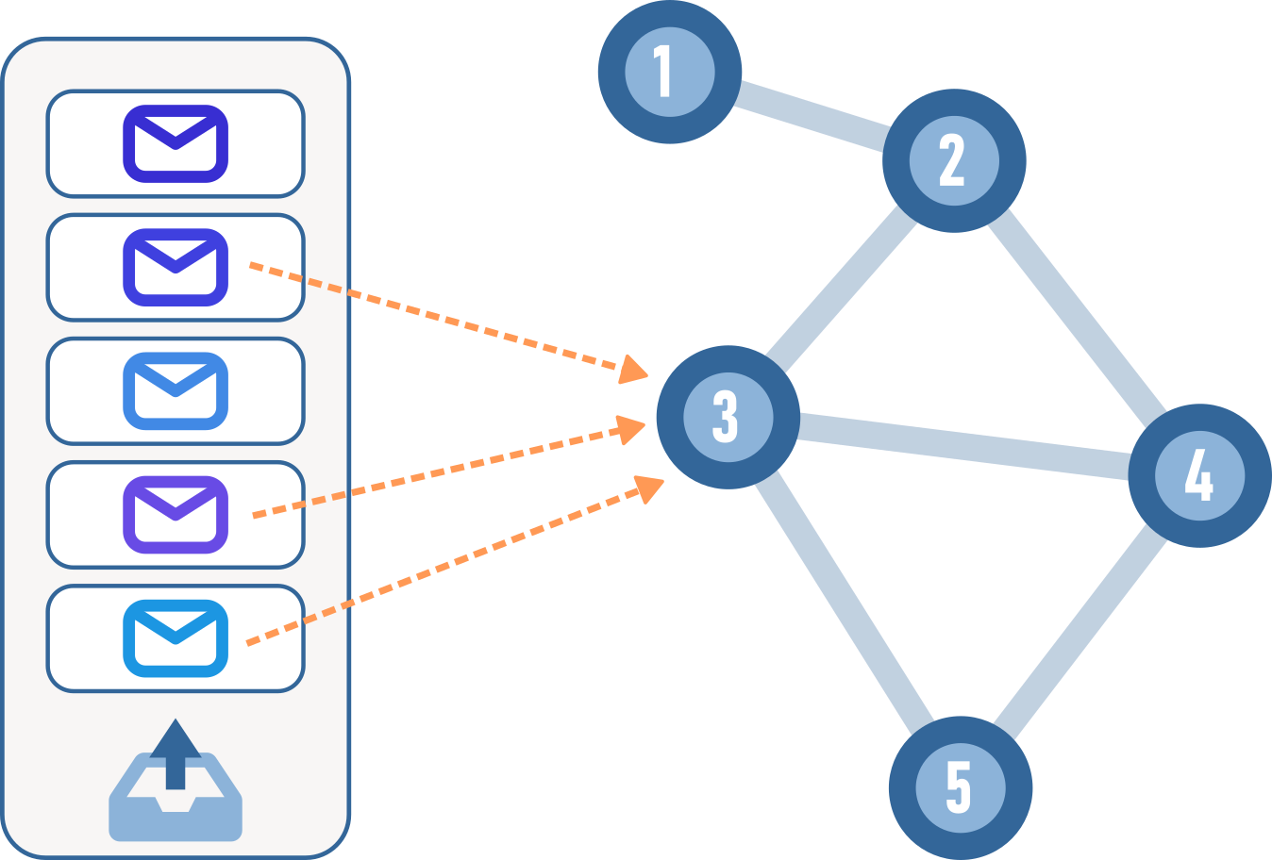
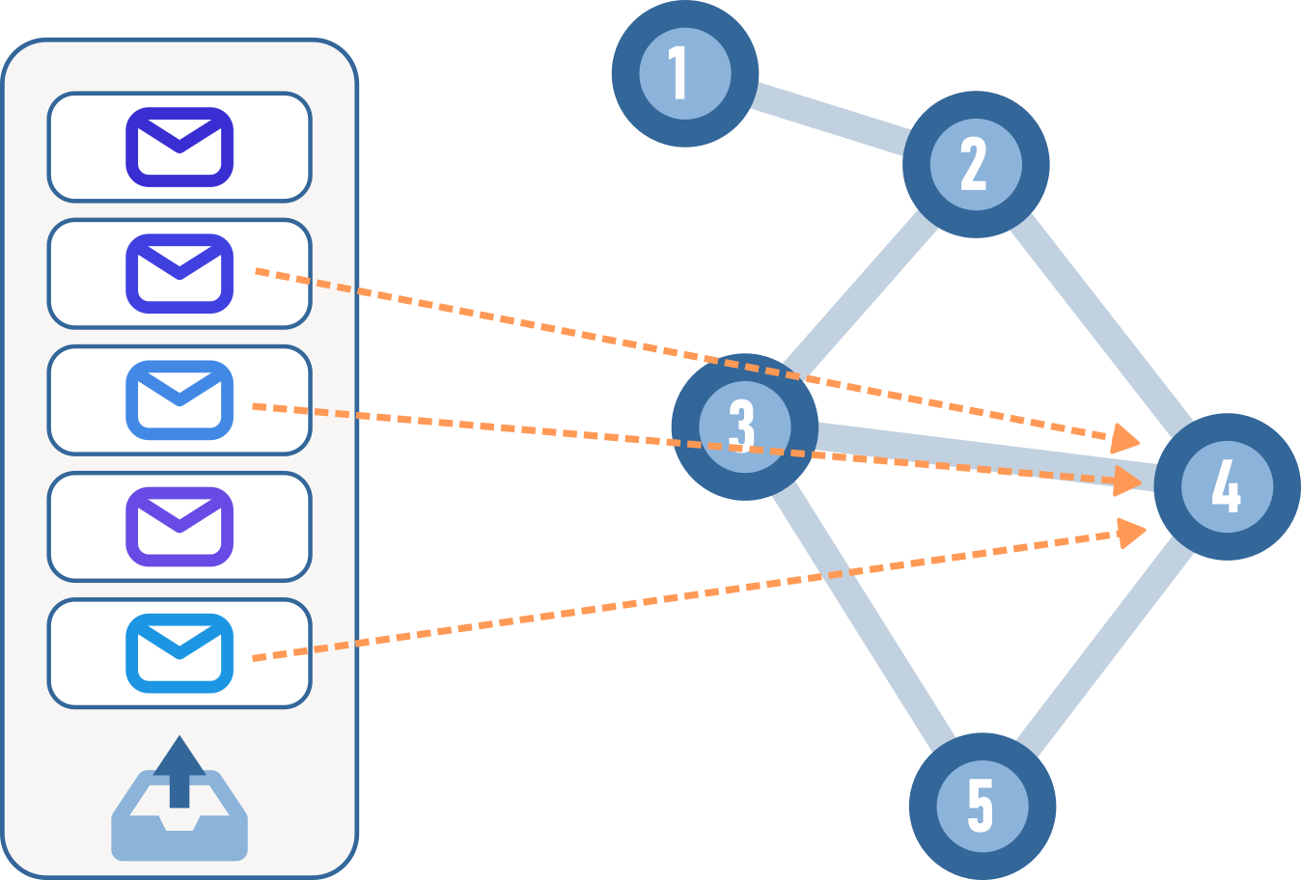
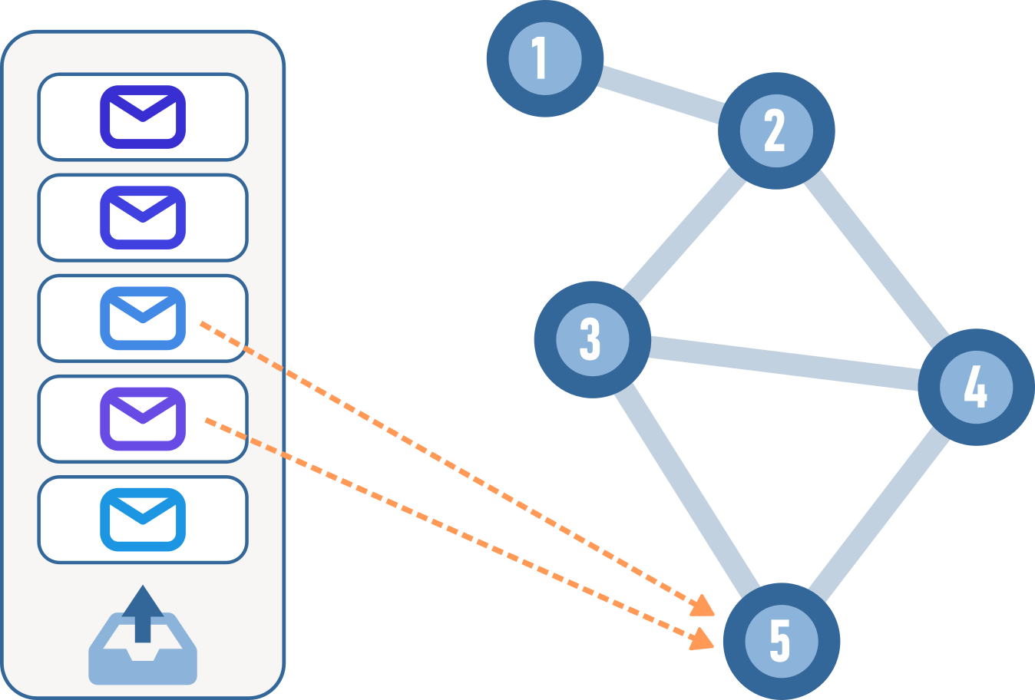
Message passing in practice

Slide 13
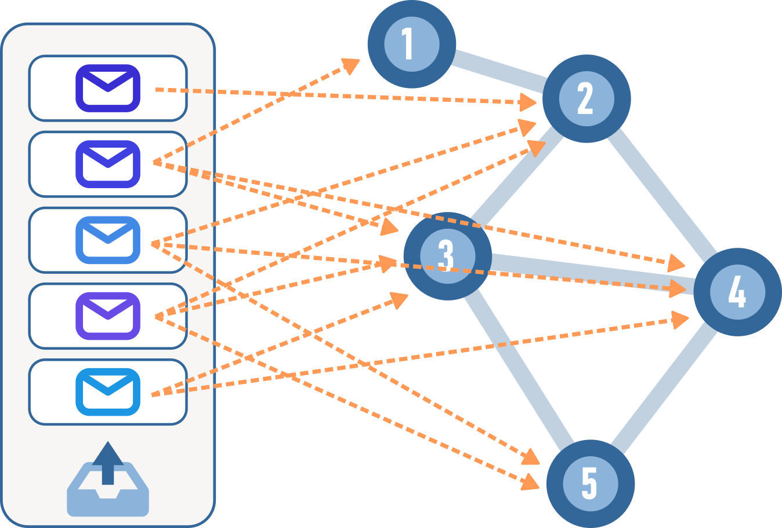
Message passing in practice

Slide 14
Message passing in practice
=
The number of “mail slots” (rows of the node feature matrix) is not fixed
We use as many as there are nodes

Slide 15
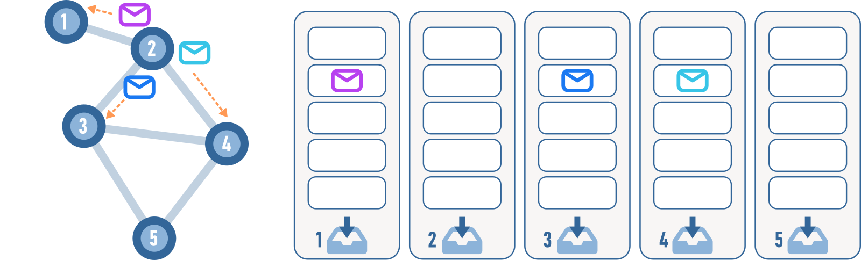
Personalized messages?

Slide 16
Edge features are “personal”
≈

Slide 17
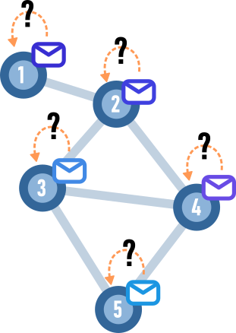
What about my previous information?

Slide 18
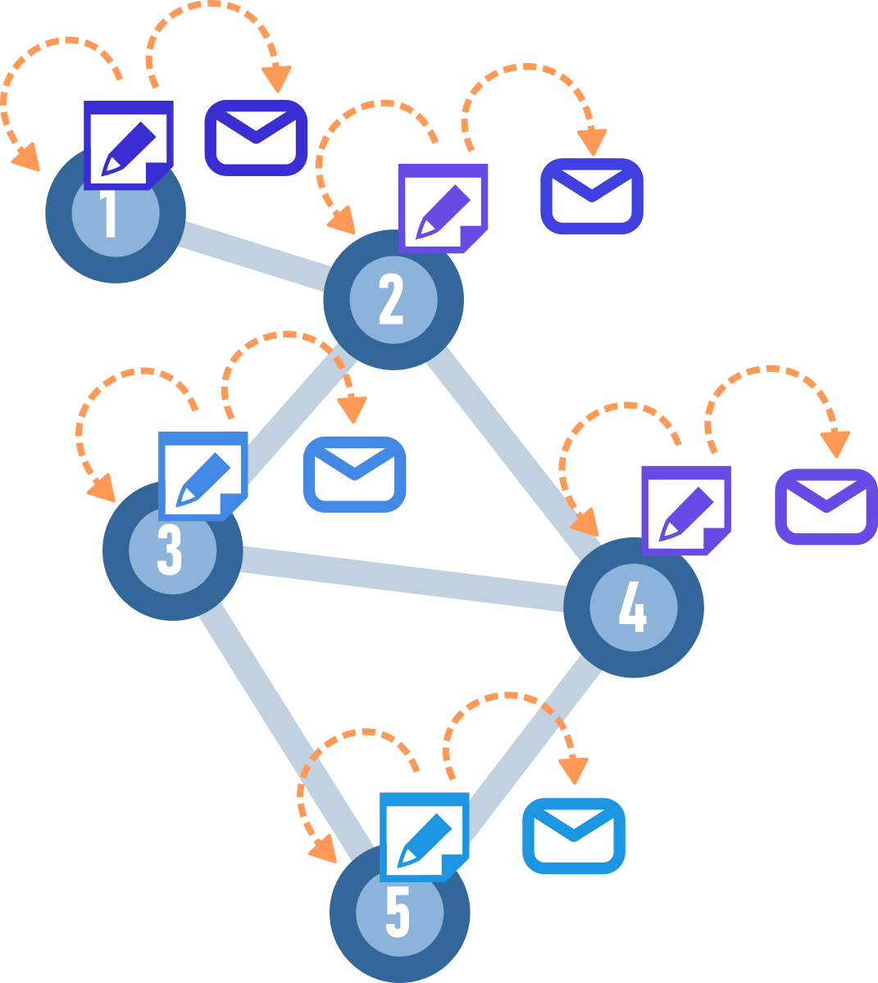
What about my previous information?
Each node keeps track of it’s own information, it has its own state
Messages to send out are derived from this state

Slide 19
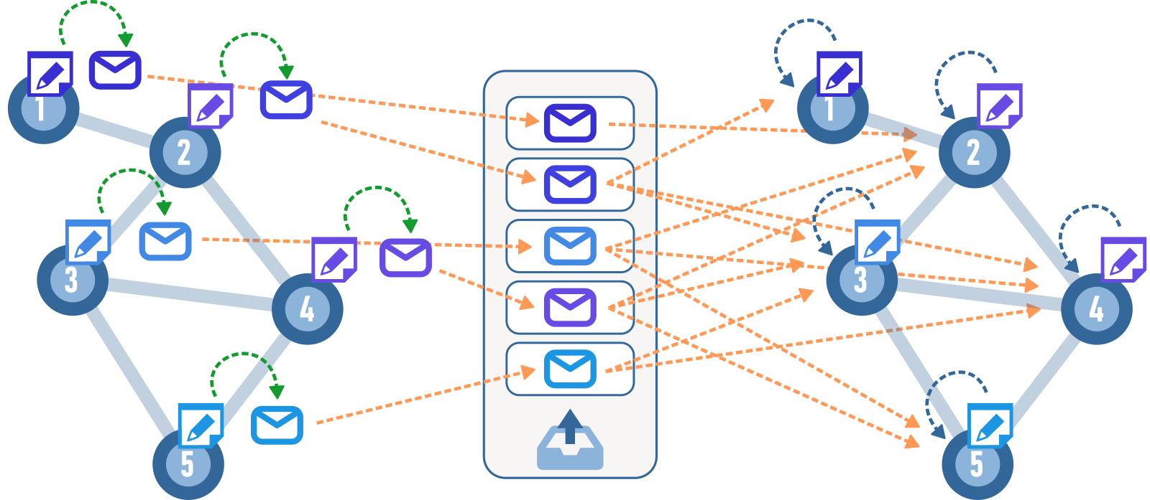
1 GNN Layer
Write messages
Outgoing messages
Aggregate information

Slide 20
Multiple layers
Each GNN layer corresponds to one round of message passing
Layer 2
Layer 1

Slide 21
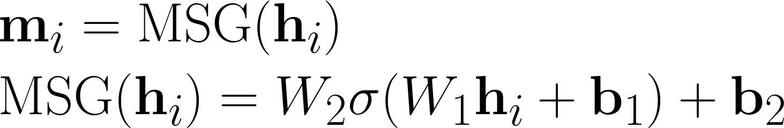
What information to pass along?
Let a neural network decide
m_{i} is the message node i sends.
h_{i} is the current information (hidden state) accumulated at node i
Notes:
\begin{align*}
&\mathbf{m}_i = \text{MSG}(\mathbf{h}_i)\\
&\text{MSG}(\mathbf{h}_i) = W_2 \sigma( W_1 \mathbf{h}_i + \mathbf{b}_1) + \mathbf{b}_2
\end{align}

Slide 22
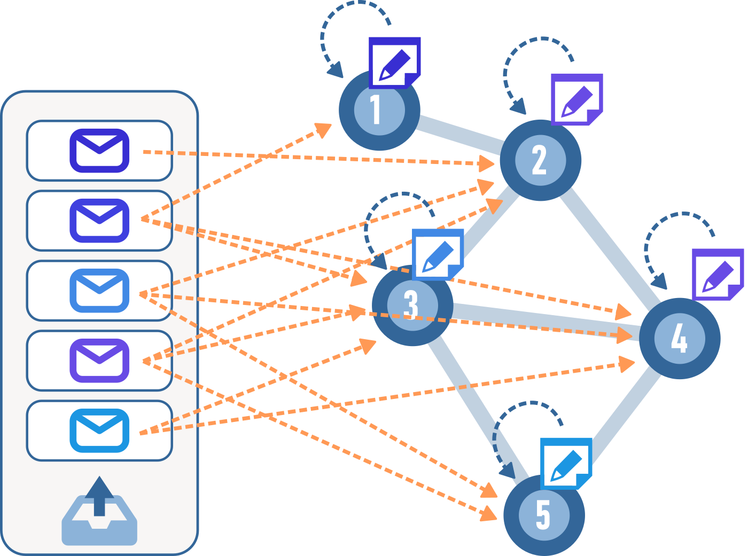
How to aggregate information?
Notes:
Should be invariant of the permutation it has. Permutation invariant and handle arbitrary size of nieighbours.

Slide 23
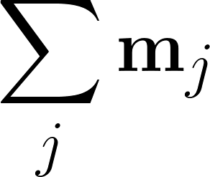
Hero of the day
Notes:
\sum_j \mathbf{m}_j ,
Using sum is or expressive than mean and mean is more expressive than max. So we should not use or prefer to use max.

Slide 24
Why is sums of vectors useful
Permutation invariance

Slide 25
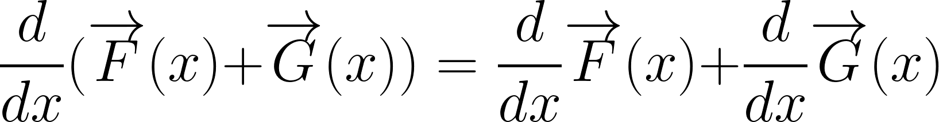
Why is sums of vectors useful
Easy to differentiate
Notes:
\frac{d}{dx}(\overrightarrow{F}(x) + \overrightarrow{G}(x)) = \frac{d}{dx}\overrightarrow{F}(x) + \frac{d}{dx}\overrightarrow{G}(x) ,
They are all vectors, so they are easily differentiated from each other.

Slide 26
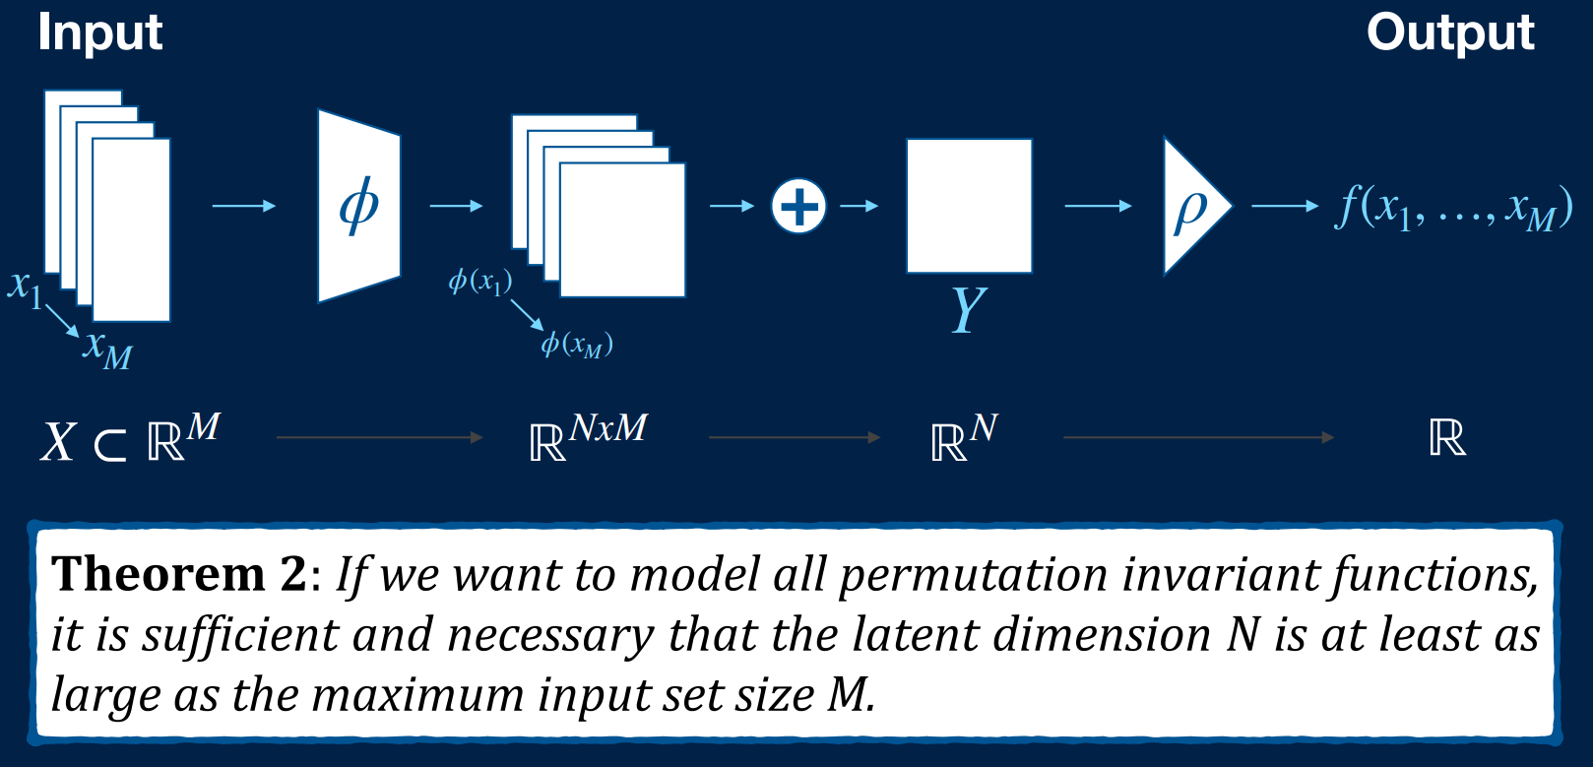
Universal approximator
Wagstaff, Edward, et al. "On the limitations of representing functions on sets." International Conference on Machine Learning. PMLR, 2019.

Slide 27
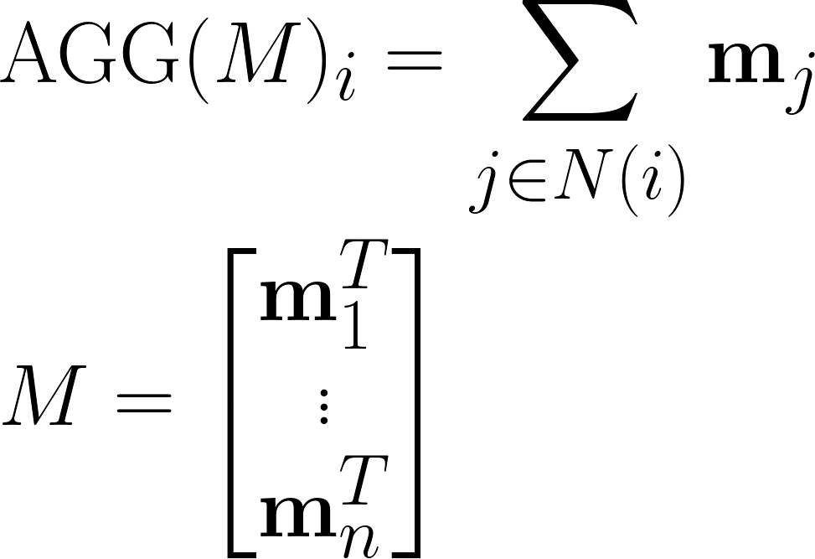
How to aggregate information?
M

Slide 28
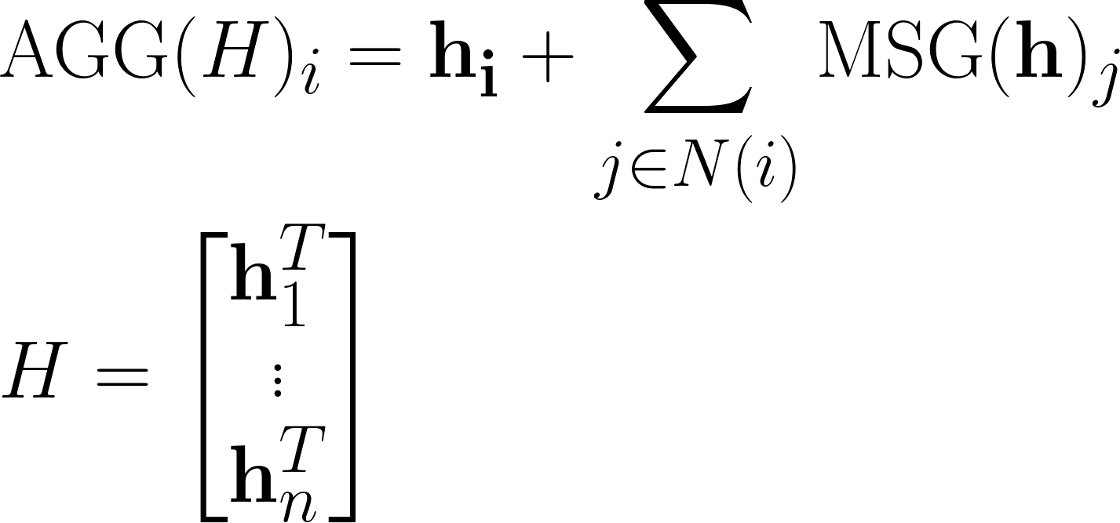
How to aggregate information?
M
Notes:
\begin{align*}
&\text{AGG}(H)_i = \mathbf{h_i} + \sum_{j \in N(i)} \text{MSG}(\mathbf{h})_j \\
&H = \begin{bmatrix} \mathbf{h}_1^T \\ \vdots \\ \mathbf{h}_n^T \end{bmatrix}
\end{align*}

Slide 29
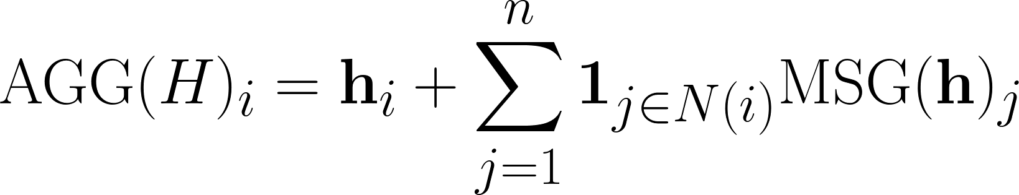
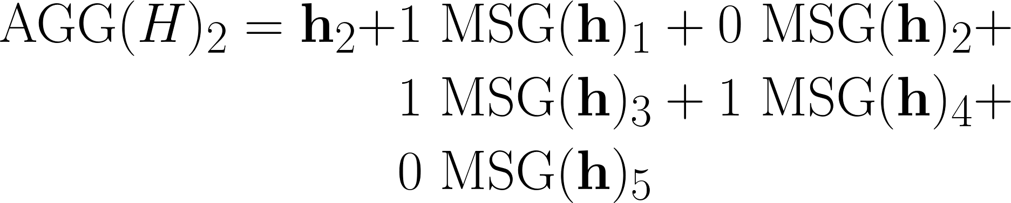
The aggregation as a vector multiplication
M
Notes:
\begin{align*}
&\text{AGG}(H)_i = \mathbf{h}_i + \sum_{j=1}^n \mathbf{1}_{j \in N(i)}\text{MSG}(\mathbf{h})_j \\
&\text{AGG}(H)_2 = \mathbf{h}_2 + 1~\text{MSG}(\mathbf{h})_1 + 0~\text{MSG}(\mathbf{h})_2 + 1~\text{MSG}(\mathbf{h})_3 + 1~\text{MSG}(\mathbf{h})_4 + 0~\text{MSG}(\mathbf{h})_5
\end{align*}
\begin{align*}
\text{AGG}(H)_i = \mathbf{h}_i + \begin{bmatrix} \mathbf{1}_{1 \in N(i)} & ... & \mathbf{1}_{n \in N(i)}\end{bmatrix}
\begin{bmatrix} \text{MSG}(\mathbf{h})_1^T \\
\vdots \\
\text{MSG}(\mathbf{h})_n^T
\end{bmatrix}
\end{align*}

Slide 30
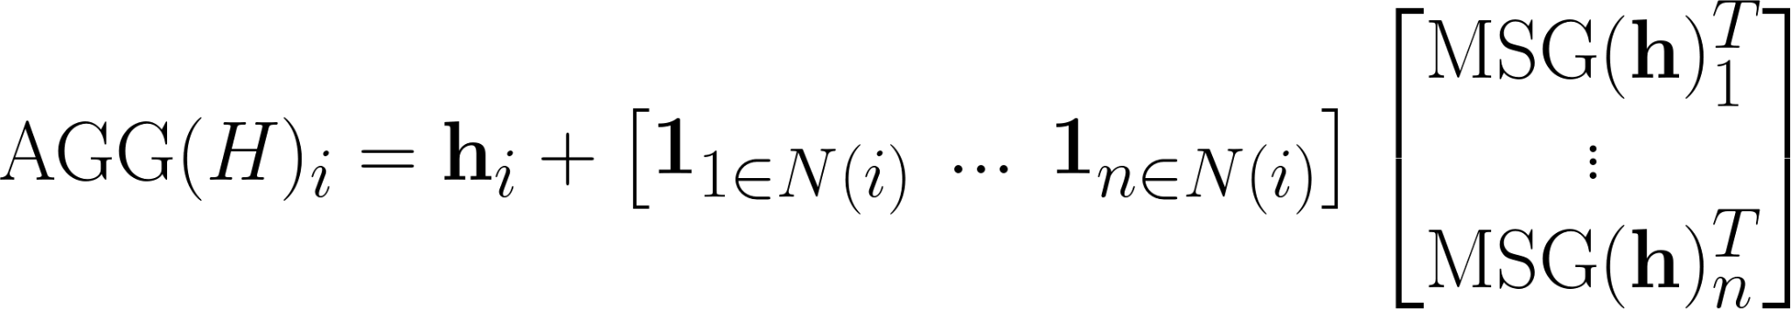
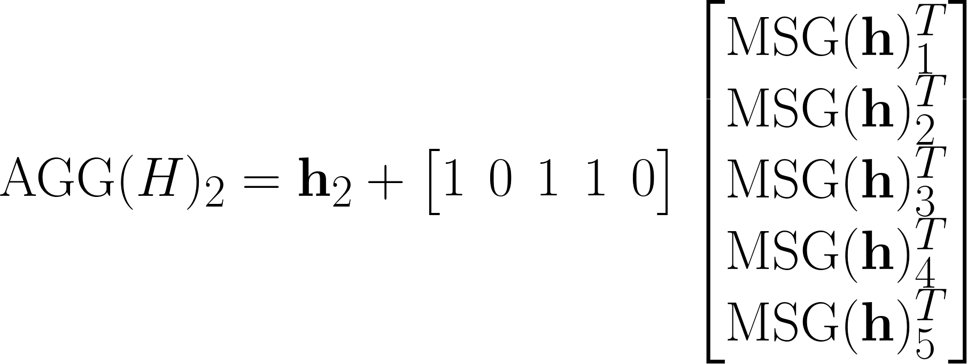
The aggregation as a vector multiplication
M
Notes:
\begin{align*}
&\text{AGG}(H)_i = \mathbf{h}_i + \sum_{j=1}^n \mathbf{1}_{j \in N(i)}\text{MSG}(\mathbf{h})_j \\
&\text{AGG}(H)_2 = \mathbf{h}_2 + 1~\text{MSG}(\mathbf{h})_1 + 0~\text{MSG}(\mathbf{h})_2 + 1~\text{MSG}(\mathbf{h})_3 + 1~\text{MSG}(\mathbf{h})_4 + 0~\text{MSG}(\mathbf{h})_5
\end{align*}
\begin{align*}
\text{AGG}(H)_i = \mathbf{h}_i + \begin{bmatrix} \mathbf{1}_{1 \in N(i)} & ... & \mathbf{1}_{n \in N(i)}\end{bmatrix}
\begin{bmatrix} \text{MSG}(\mathbf{h})_1^T \\
\vdots \\
\text{MSG}(\mathbf{h})_n^T
\end{bmatrix}
\end{align*}

Slide 31
The aggregation as a vector multiplication
The second row from the adjacency matrix!
M
Notes:
\begin{align*}
&\text{AGG}(H)_i = \mathbf{h}_i + \sum_{j=1}^n \mathbf{1}_{j \in N(i)}\text{MSG}(\mathbf{h})_j \\
&\text{AGG}(H)_2 = \mathbf{h}_2 + 1~\text{MSG}(\mathbf{h})_1 + 0~\text{MSG}(\mathbf{h})_2 + 1~\text{MSG}(\mathbf{h})_3 + 1~\text{MSG}(\mathbf{h})_4 + 0~\text{MSG}(\mathbf{h})_5
\end{align*}
\begin{align*}
\text{AGG}(H)_i = \mathbf{h}_i + \begin{bmatrix} \mathbf{1}_{1 \in N(i)} & ... & \mathbf{1}_{n \in N(i)}\end{bmatrix}
\begin{bmatrix} \text{MSG}(\mathbf{h})_1^T \\
\vdots \\
\text{MSG}(\mathbf{h})_n^T
\end{bmatrix}
\end{align*}

Slide 32
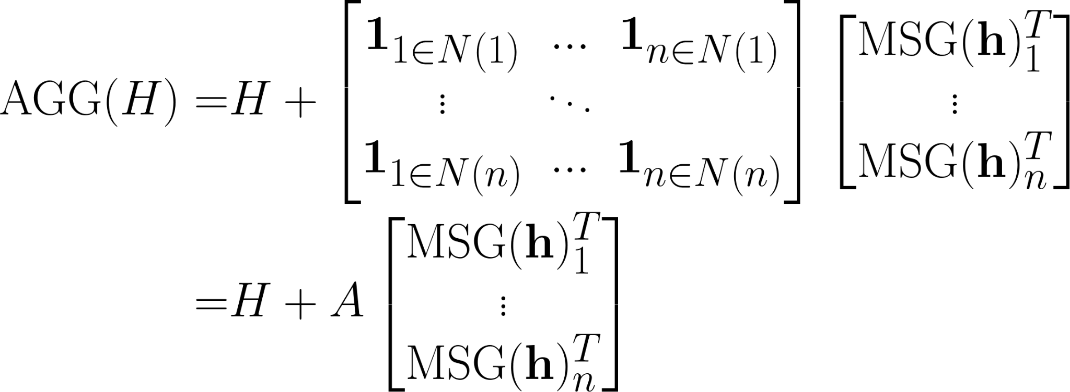
All aggregations as a matrix multiplication
M
Notes:
\begin{align*}
&\text{AGG}(H)_i = \mathbf{h}_i + \sum_{j=1}^n \mathbf{1}_{j \in N(i)}\text{MSG}(\mathbf{h})_j \\
&\text{AGG}(H)_2 = \mathbf{h}_2 + 1~\text{MSG}(\mathbf{h})_1 + 0~\text{MSG}(\mathbf{h})_2 + 1~\text{MSG}(\mathbf{h})_3 + 1~\text{MSG}(\mathbf{h})_4 + 0~\text{MSG}(\mathbf{h})_5
\end{align*}
\begin{align*}
\text{AGG}(H)_i = \mathbf{h}_i + \begin{bmatrix} \mathbf{1}_{1 \in N(i)} & ... & \mathbf{1}_{n \in N(i)}\end{bmatrix}
\begin{bmatrix} \text{MSG}(\mathbf{h})_1^T \\
\vdots \\
\text{MSG}(\mathbf{h})_n^T
\end{bmatrix}
\end{align*}

Slide 33
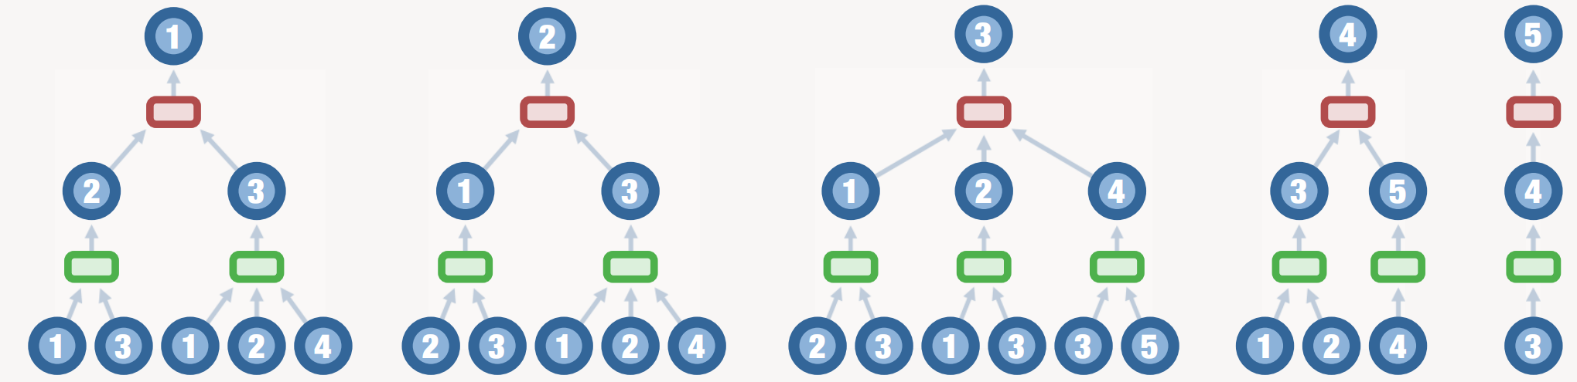
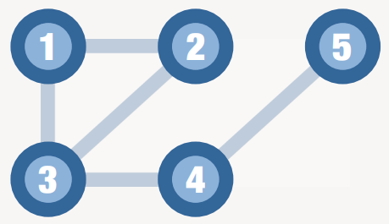
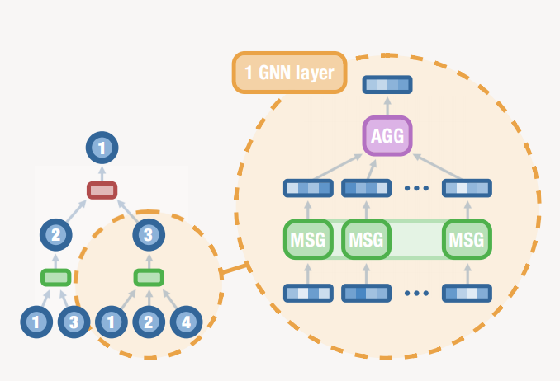
Full picture
Unfolded two layer GNN. At the top is information aggregated after two steps of message passing in the different nodes
Notes:
\begin{align*}
&\text{AGG}(H)_i = \mathbf{h}_i + \sum_{j=1}^n \mathbf{1}_{j \in N(i)}\text{MSG}(\mathbf{h})_j \\
&\text{AGG}(H)_2 = \mathbf{h}_2 + 1~\text{MSG}(\mathbf{h})_1 + 0~\text{MSG}(\mathbf{h})_2 + 1~\text{MSG}(\mathbf{h})_3 + 1~\text{MSG}(\mathbf{h})_4 + 0~\text{MSG}(\mathbf{h})_5
\end{align*}
\begin{align*}
\text{AGG}(H)_i = \mathbf{h}_i + \begin{bmatrix} \mathbf{1}_{1 \in N(i)} & ... & \mathbf{1}_{n \in N(i)}\end{bmatrix}
\begin{bmatrix} \text{MSG}(\mathbf{h})_1^T \\
\vdots \\
\text{MSG}(\mathbf{h})_n^T
\end{bmatrix}
\end{align*}

Slide 34
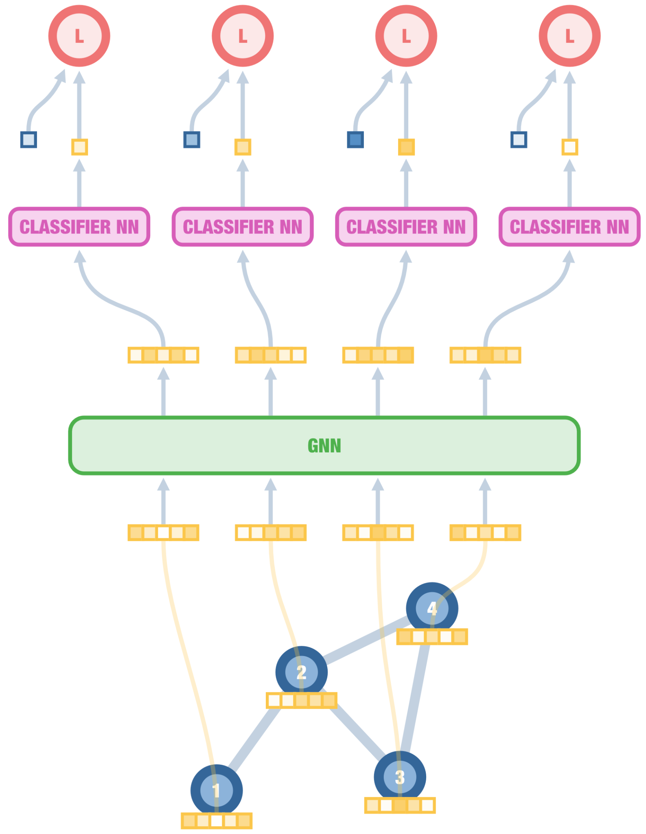
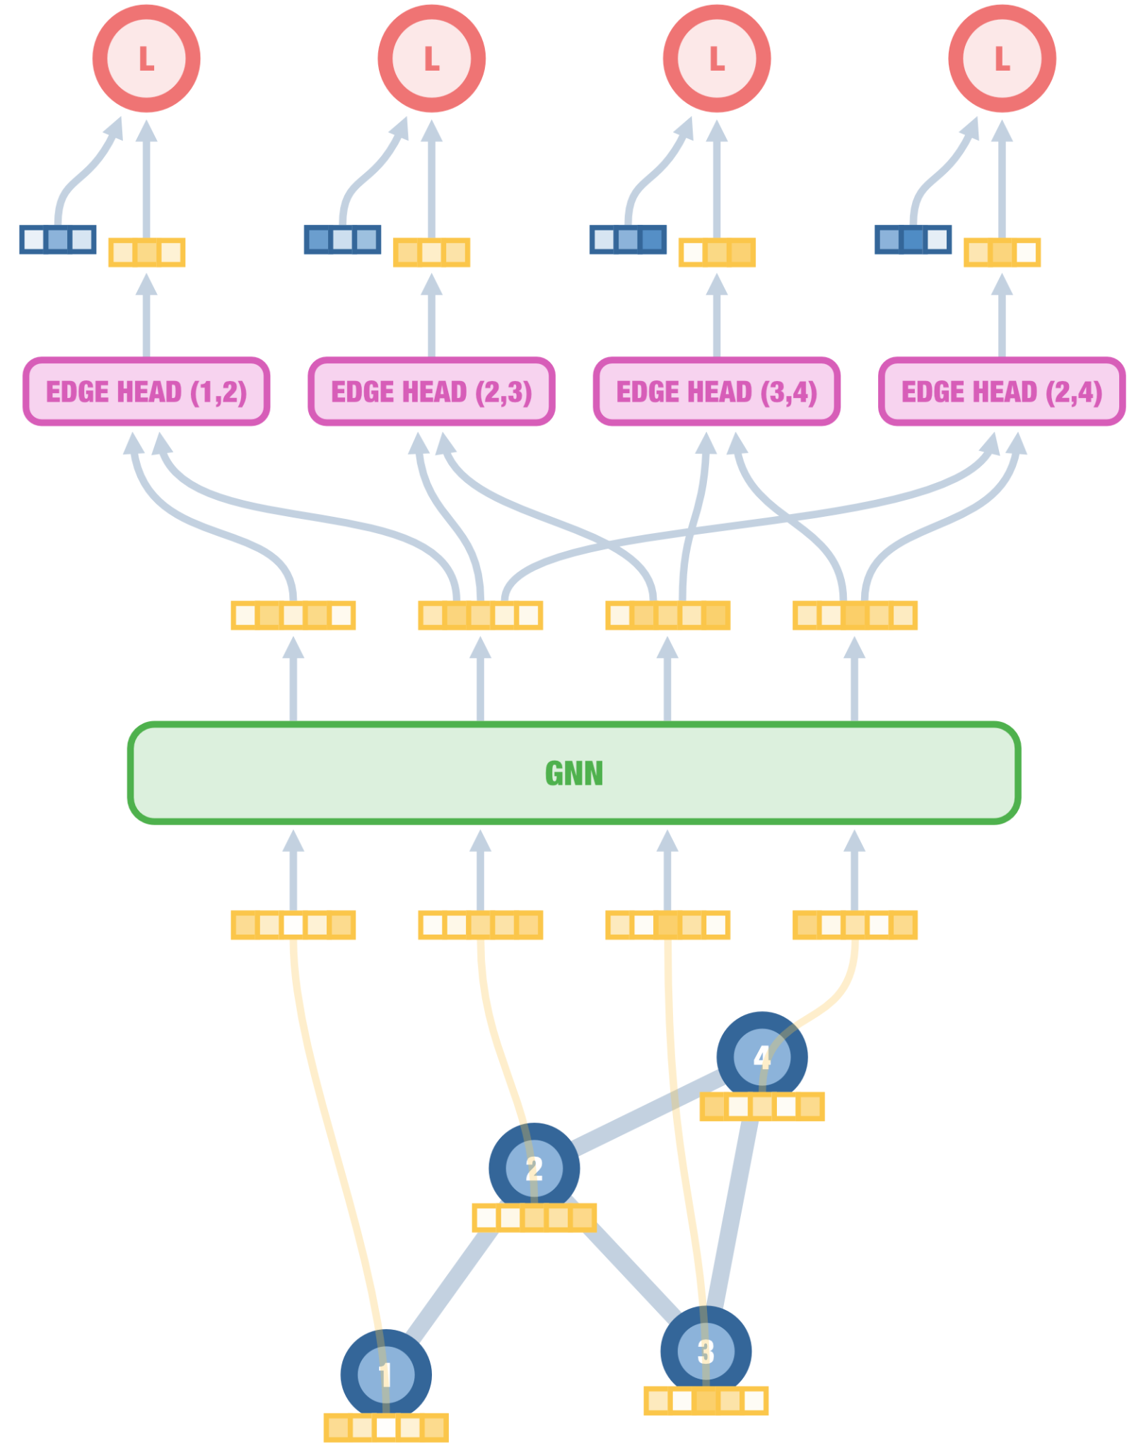
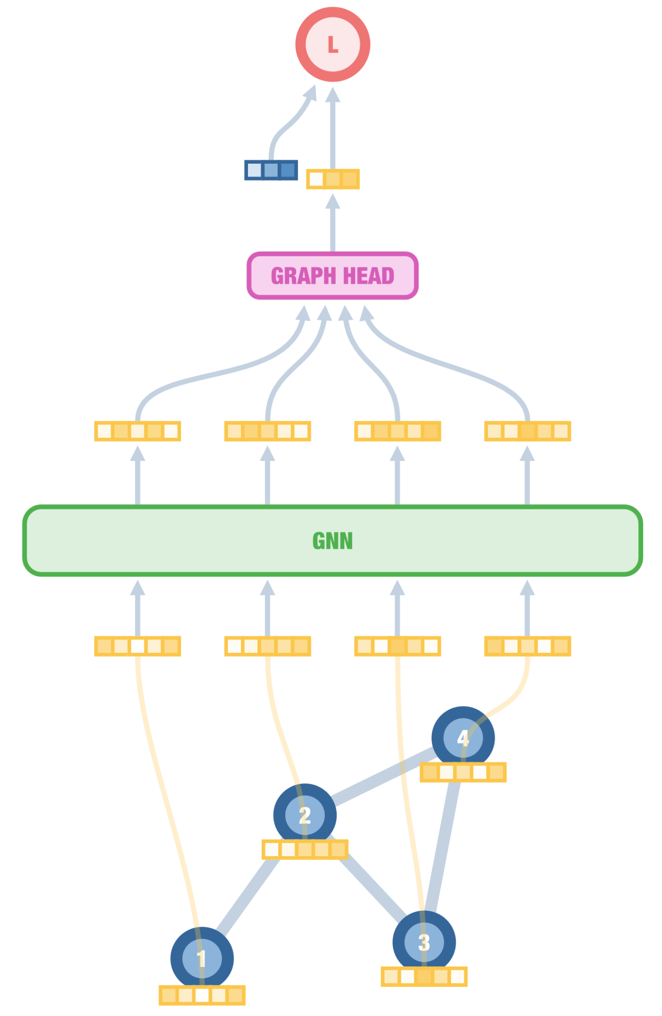
Inductive graph learning
Three levels of granularity
Node prediction
User role in social network
Edge/pair prediction
Pairwise forces in a neural force field
Graph prediction
Molecular property prediction

Slide 35
Thank you!
enccs.se

